Slide 1



SOCIAL MEDIA ANALYTICS DASHBOARD
PROJECT GUIDE
Dr.S.Varadhaganapathy PhD.,
PROJECT MEMBERS
Giridharan S – 22ITR025
Kaviya S – 22ITR044
Jagan S – 22ITL122

Slide 2
INTRODUCTION
Social media generates vast amounts of data, making it difficult for businesses to track and analyze performance metrics across multiple platforms.
Users face challenges in identifying key insights, monitoring trends, and measuring the impact of campaigns.
A need exists for a unified platform that simplifies data collection, visualization, and analysis from social media platform for tracking and Analyzing User engagement.

Slide 3
OBJECTIVE
To develop a centralized dashboard to track and analyze social media data in a user-friendly way.
To provide actionable insights by presenting data in clear, visual formats.
To facilitate better decision-making for marketing strategies based on comprehensive analytics.
To automate the process of data retrieval and report generation to save time and effort for users.

Slide 4
PROJECT DESCRIPTION
The Social Media Analytics Dashboard is designed to aggregate data from platform like YouTube,Twitter.
It enables users to view critical metrics like engagement, follower growth, post performance, and demographic insights.
With this dashboard, users can track their social media strategy in real-time, identify trends, and make informed decisions.

Slide 5
MODULE DESCRIPTION
YouTube Module
This module provides analytics for YouTube channels.
Key Metrics:
Channel name, Subscriber count, Total video views, Number of uploaded videos, Recent videos' analytics (views, likes).
Functionality:
It uses YouTube Data API v3 to fetch the channel's information and video metrics. This module will display insights into the channel's performance and the engagement level of the latest videos.

Slide 6
MODULE DESCRIPTION
Twitter Module:
This module provides analytics for Twitter profiles.
Key Metrics:
Username, Number of posts, Number of followers, Number of following, Recent tweets' engagement (likes, comments, reposts, views), Joined date.
Functionality:
Uses web scraping with Puppeteer to fetch data directly from Twitter, displaying a profile overview and engagement analytics as bar graphs.

Slide 7
TECHNOLOGY USED
Frontend: React js, react-chartjs-2
Backend: Node.js, Express.js for API handling, Web Scrapping.
APIs: Integration with social media APIs (YouTube v3 API).
Version Control: Git, GitHub.

Slide 8
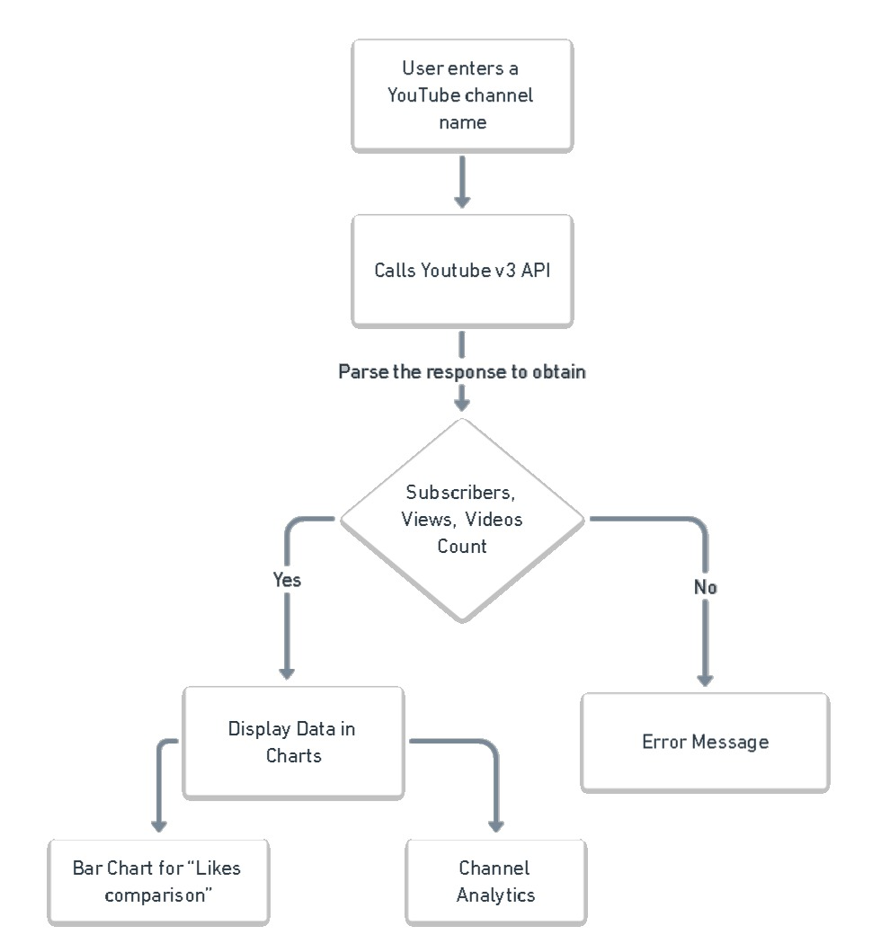
ARCHITECTURE

Slide 9
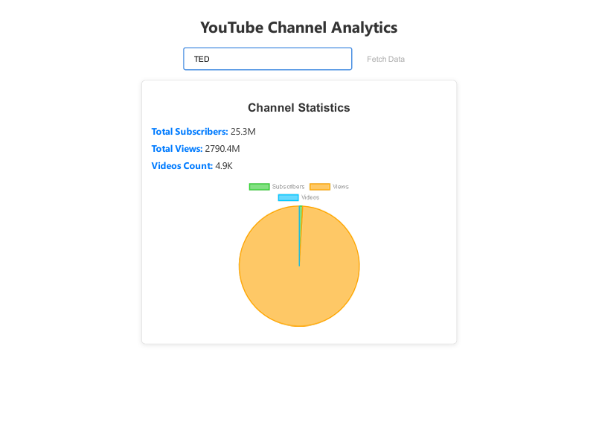
OUTPUT SCREENSHOT

Slide 10
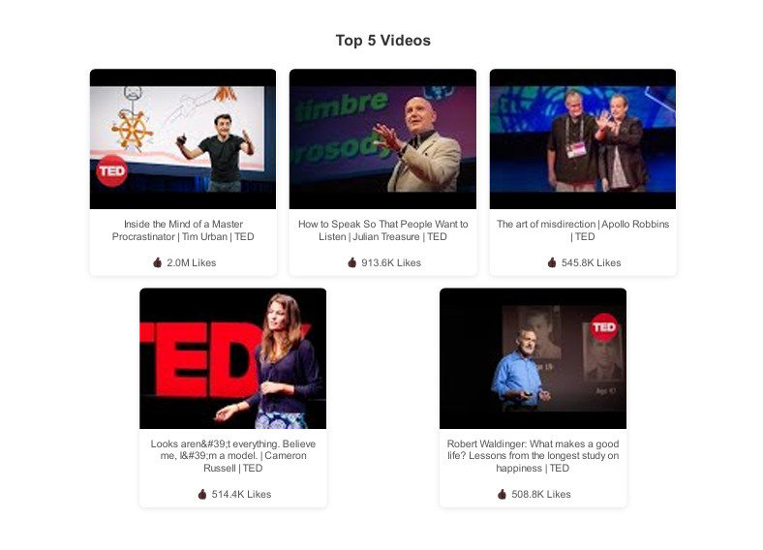
OUTPUT SCREENSHOT

Slide 11
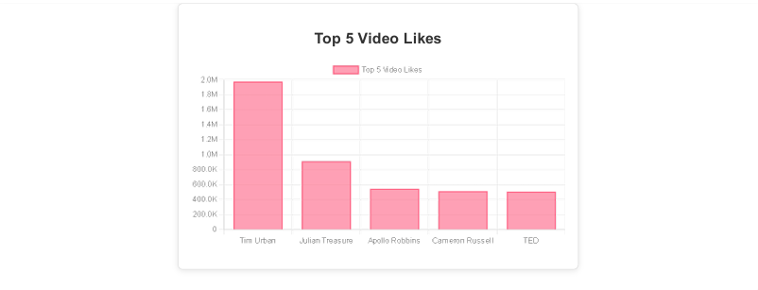
OUTPUT SCREENSHOT

Slide 12
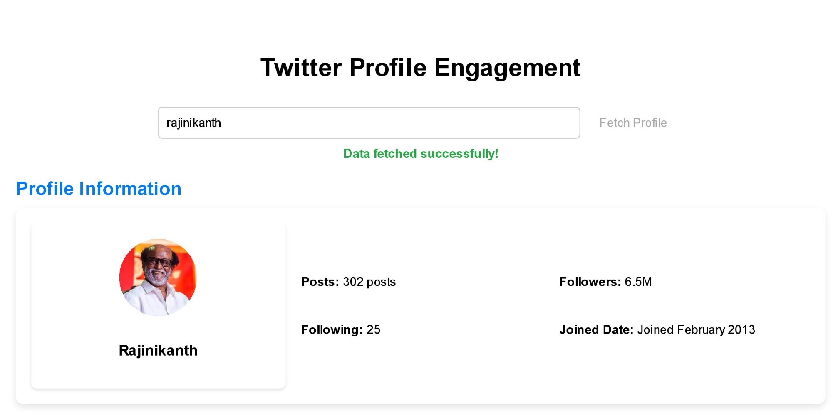
OUTPUT SCREENSHOT

Slide 13
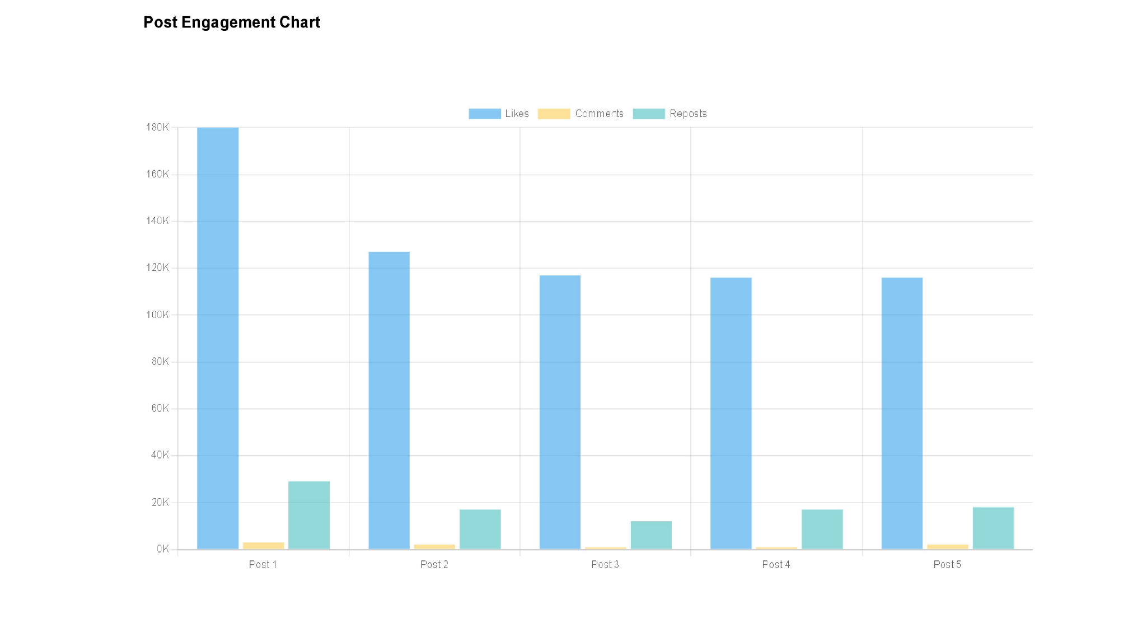
OUTPUT SCREENSHOT

Slide 14
THANK YOU

